Slide 1
Communicating with Data – Perception and Color
Dr. Ab Mosca (they/them)
Slides based off slides courtesy of Jordan Crouser (https://jcrouser.github.io/)

Slide 2
Plan for Today
What is perception?
How does it work?
Pre-attentive processing
Gestalt Psychology
Attentive processing
Color 101
How we see color
What this means for visualization
More perceptual problems
Takeaways
Note: I’m going to flash a bunch of slides quickly today. If that doesn’t work for you, you are welcome to step out, close your eyes, etc.. (none of us will be offended and I will fill you in on anything crucial you missed!)

Slide 3
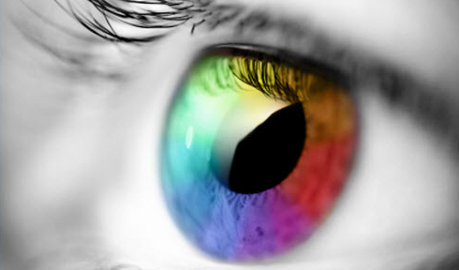
What is perception?

Slide 4
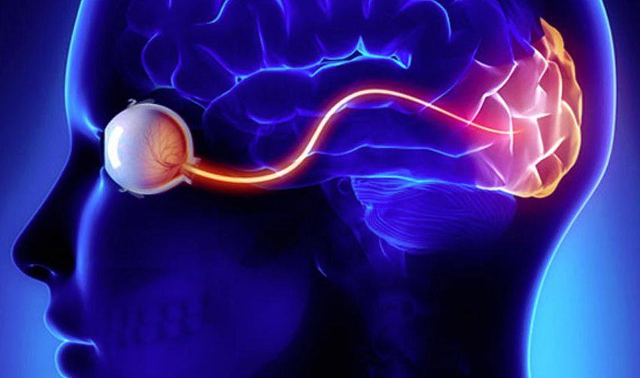
Visual perception (def.)
the (sometimes imperfect)
process by which we
detect and interpret
visual signals

Slide 5
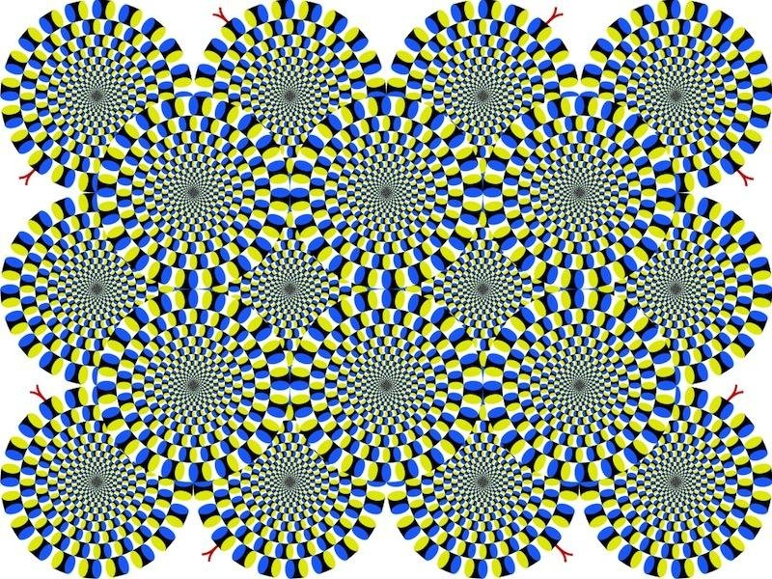
Do you see movement?

Slide 6
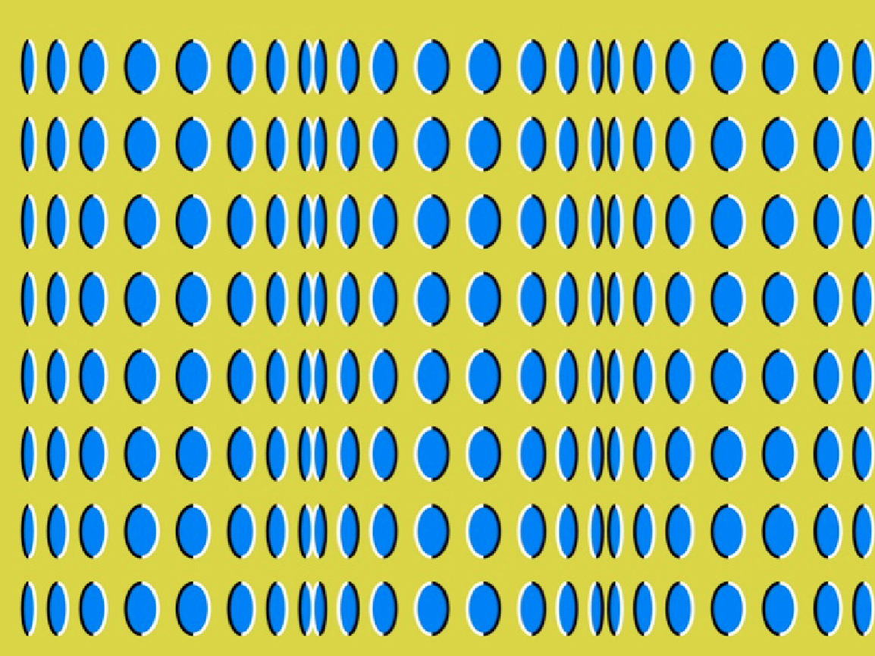
Do you see movement?

Slide 7
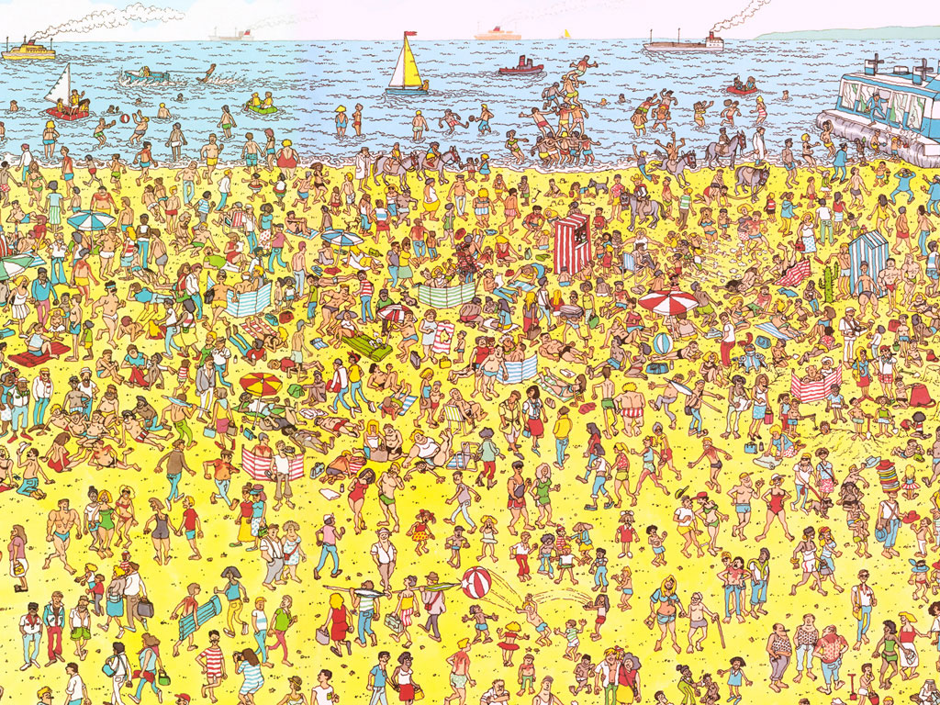
Some things are processed slowly
Visual perception

Slide 8
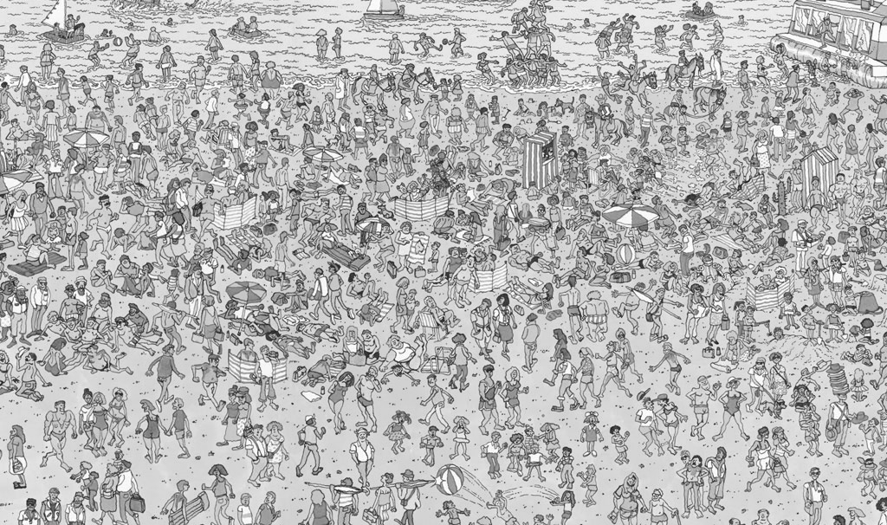
Others are incredibly fast
Visual perception

Slide 9
Fast = “pre-attentive processing”
Pre-attentive processing
Things that happen in <200ms of visual stimulation
Performed in parallel across the entire visual field
Example…
Notes:
Flash image on next screen

Slide 10
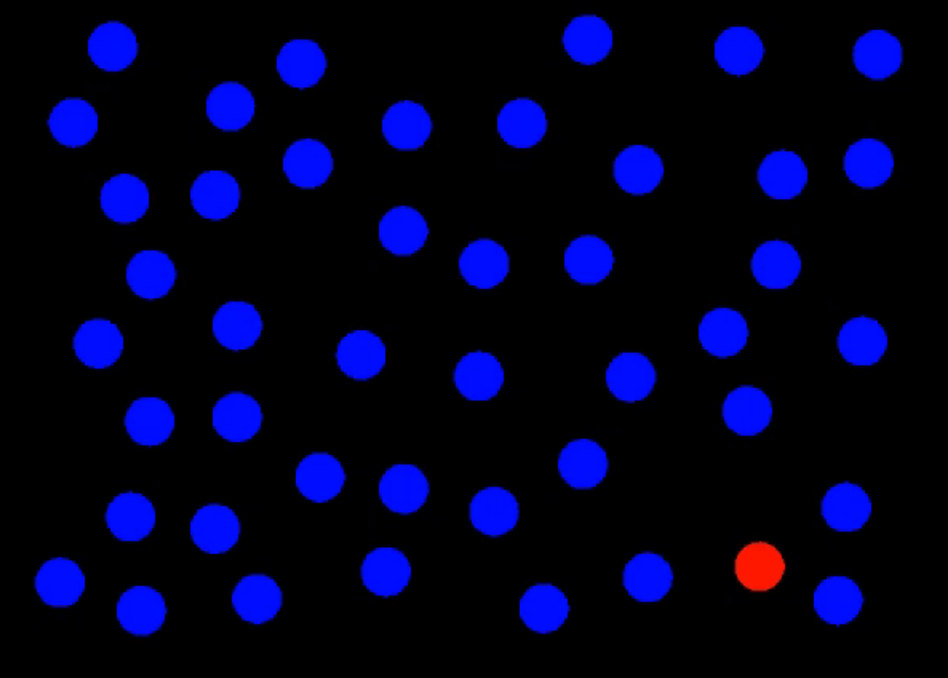
Pre-attentive processing

Slide 11
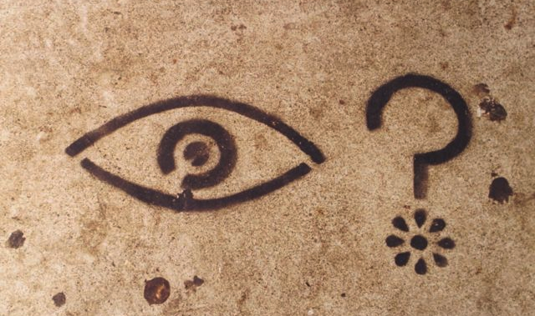
What did you see?
Pre-attentive processing
Notes:
Clocked my spacebar double-tap ability at about 80ms on average.
Without knowing what you were going to see, you likely attuned to the red dot in the field of blue dots.
This is the power of preattentive processing.

Slide 12
Pre-attentive processing
“An understanding of what is processed pre-attentively is probably the most important contribution that visual science can make to data visualization” (Ware, 2004, p. 19)

Slide 13
Pre-attentive processing facilitates:
Target detection (presence or absence)
Boundary detection / grouping
Region tracking
Counting and estimation
Notes:
Now I’m going to flash an image on the screen

Slide 14
Pre-attentive processing facilitates:
Target detection (presence or absence)
Boundary detection / grouping
Region tracking
Counting and estimation
On the next slide I want you to count how many zeros you see as fast as you can. Raise your hand (do not shout the number) when you have the answer.
Notes:
Now I’m going to flash an image on the screen

Slide 15
Attentive counting
1281768756138976546984506985624982826762
9809858458224519856458945098459985943585
9891330249945959595772564675750678974567
8845789819821677654876364968560912949686
How many zeros are there?
Notes:
Same on next slide but threes

Slide 16
Attentive counting
We’ll do the same on the next slide for threes.
Notes:
Same on next slide but threes

Slide 17
Pre-attentive counting
1281768756138976546984506985604982826762
9809858458224509856458945098450980943585
9091030209905959595772564675050678904567
8845789809821677654876364908560912949686
How many threes are there?

Slide 18
Pre-attentive processing for visualization
Question 1: how do we (vis designers) use pre-attentive processing to our advantage?
Question 2: what do we need to watch out for?

Slide 19
Pre-attentive processing for visualization
There’s only one instance of something on each of the next slides. What is it?

Slide 20
Pre-attentive processing: hue

Slide 21
Pre-attentive processing: shape (curvature)

Slide 22
Pre-attentive processing: shape + hue?

Slide 23
Discussion: what’s going on here?
Answer: this is called “conjunction”
If you search for red things, you get a bunch of red circles (as well as the red triangle).
Similarly, if you search for search for triangles, you get a bunch of blue triangles (as well as the red triangle).
Either way, you have to search through them all one by one!

Slide 24
Pre-attentive processing for visualization
For each of the next slides, is there a boundary (i.e. are there multiple regions)? If yes, what are the regions?

Slide 25
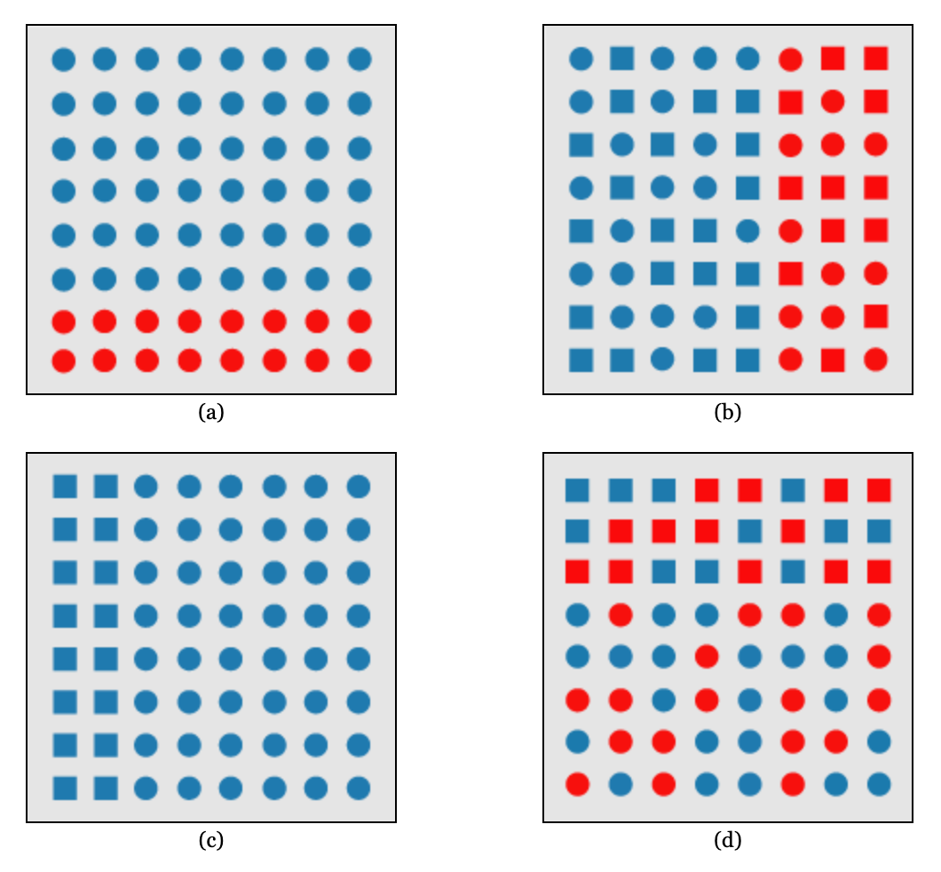
Pre-attentive processing: hue

Slide 26
Pre-attentive processing: shape (curvature)

Slide 27
Pre-attentive processing: hue + shape

Slide 28
Discussion: what’s going on here?
Answer: this is called “feature hierarchy”
During boundary detection, the visual system favors hue over shape

Slide 29
Whatever draws our eyes draws our attention
This can be useful
It can also be problematic:
Pre-attentive processing for visualization

Slide 30
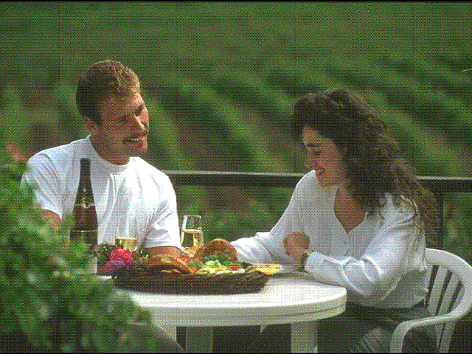
Ex. flicker can cause change blindness
Pre-attentive processing for visualization: The downsides
Notes:
What is changing? (railing moves)

Slide 31
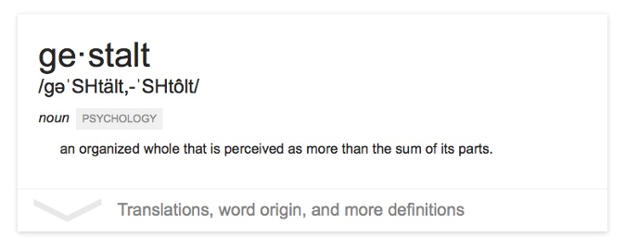
The “gestalt effect”
Our brain’s ability to generate whole forms, instead of just collections of unrelated elements

Slide 32

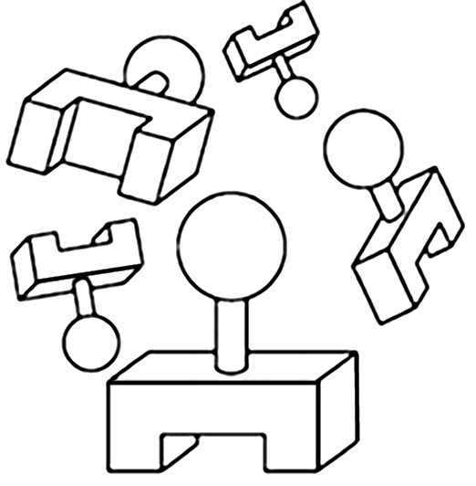
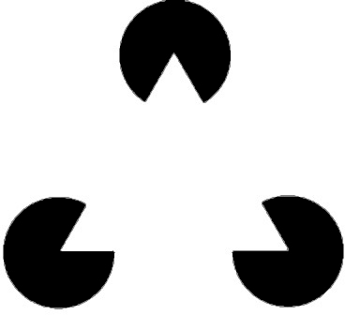
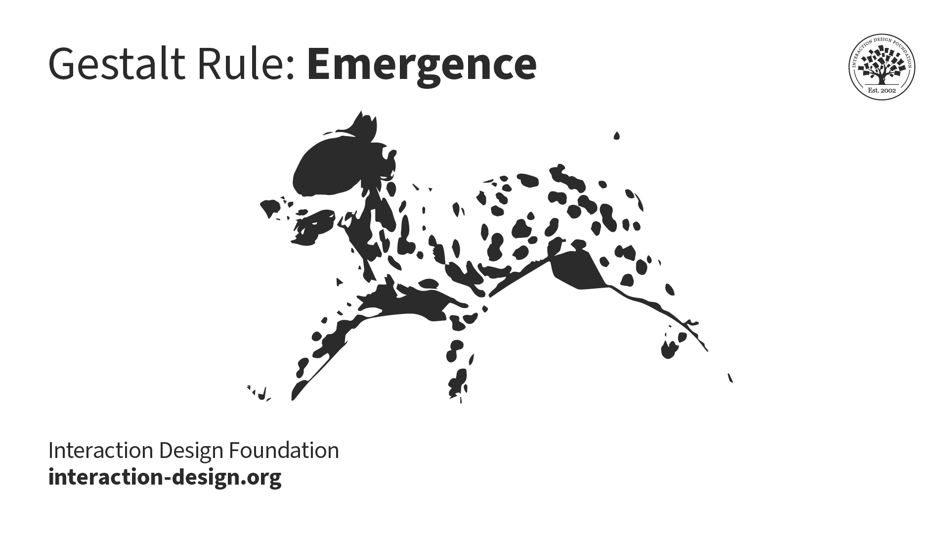
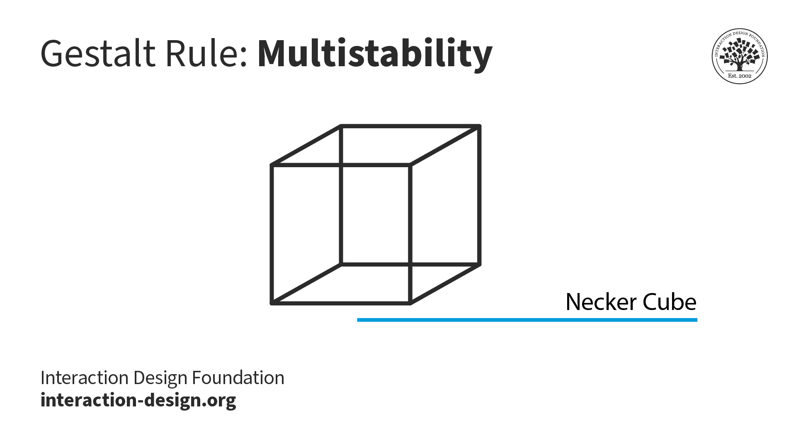
Emergence
Reification
Multistability
Invariance
Gestalt effects
Demonstration of reification in perception from Lehar S. (2003) The World In Your Head, Lawrence Erlbaum, Mahwah, NJ. p. 52, Fig. 3.3
https://www.interaction-design.org/literature/topics/gestalt-principles#docs-internal-guid-f7074e47-7fff-b4dc-f0f5-966e09f6b4e7
https://www.interaction-design.org/literature/topics/gestalt-principles#docs-internal-guid-f7074e47-7fff-b4dc-f0f5-966e09f6b4e7
Demonstration of invariance in perception from Lehar S. (2003) The World In Your Head, Lawrence Erlbaum, Mahwah, NJ. p. 53, Fig. 3.5
6 “Laws of Grouping”
Notes:
Reification – we prefer complete shapes, so we fill in the gaps between elements to complete the image
Emergence – See the big picture first, connect small parts into a big picture
Multistability – Many ways to interpret, but only see one at a time; front is back, front is front, diamond in middle
Invariance – see basic shapes as identical regardless of transformations

Slide 33
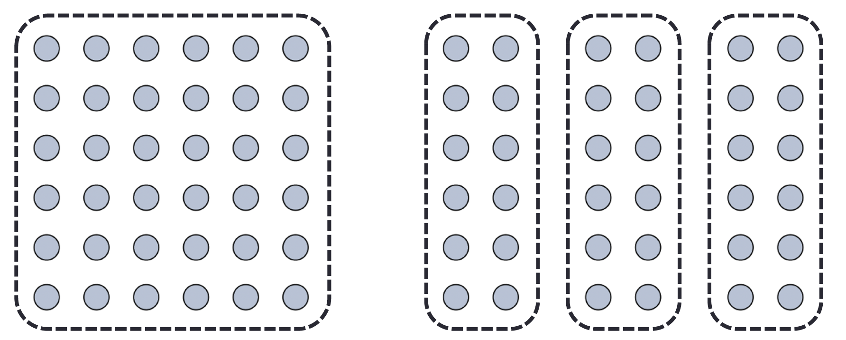
We interpret objects that are close to each other as a group
Law of Proximity
Notes:
How many groups and what are they?

Slide 34
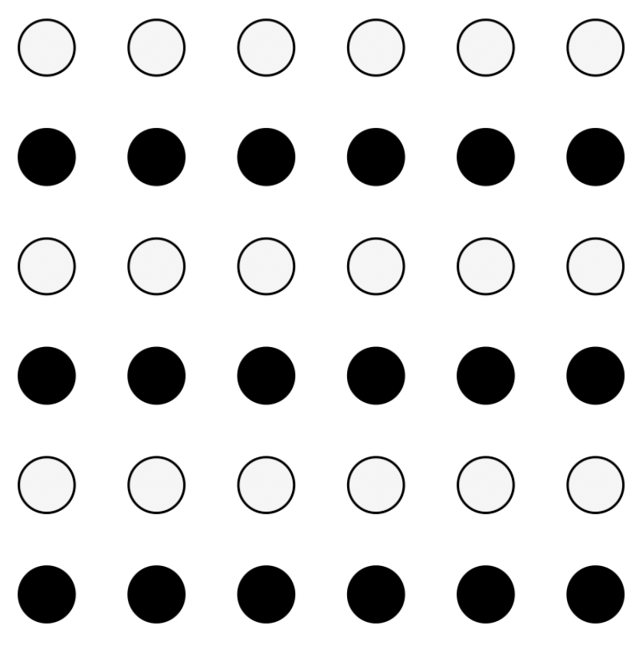
We interpret objects that are visually similar to each other as a group
Law of Similarity
“grey dots”
“black dots”

Slide 35

When parts of a picture are missing, we fill in the visual gap
Law of Closure

Slide 36
Law of Symmetry
We perceive objects as being symmetrical, arranged around a center point
law of proximity
[ ] { } [ ]
law of symmetry + law of similarity

Slide 37
We group objects that we perceive to be moving along the same path
Law of Common Fate

Slide 38
We tend to group objects along the smoothest path
Law of Continuity

Slide 39

Break into teams of 3
Choose a visualization from the Tableau Vis of the Day collection: https://public.tableau.com/app/discover/viz-of-the-day
Goal: identify as many examples of the Laws of Grouping (Gestalt Principles) in action in your sample visualization as you can
Be prepared to present your findings to the class
Let’s Practice ~10 minutes
[ ]
proximity
similarity
closure
symmetry
common fate
continuity

Slide 40
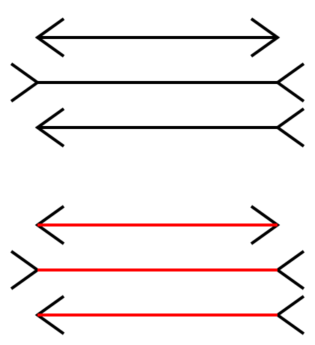
Sometimes gestalt & pre-attention compete
Pre-attentive processing for visualization: The downsides
Notes:
Lines seem different sizes

Slide 41
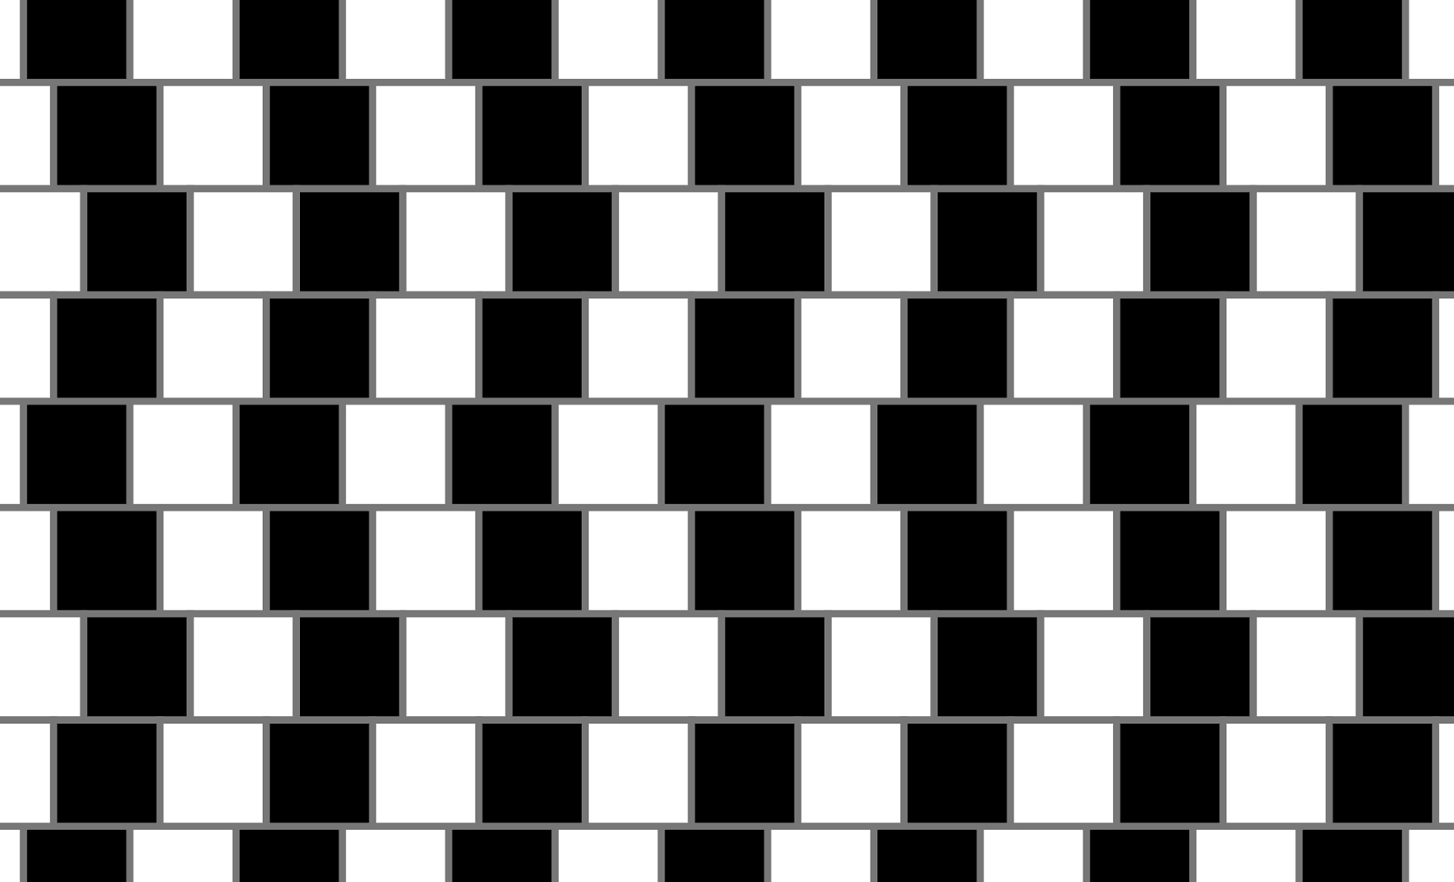
Sometimes gestalt & pre-attention compete
Pre-attentive processing for visualization: The downsides
Notes:
All right angles

Slide 42
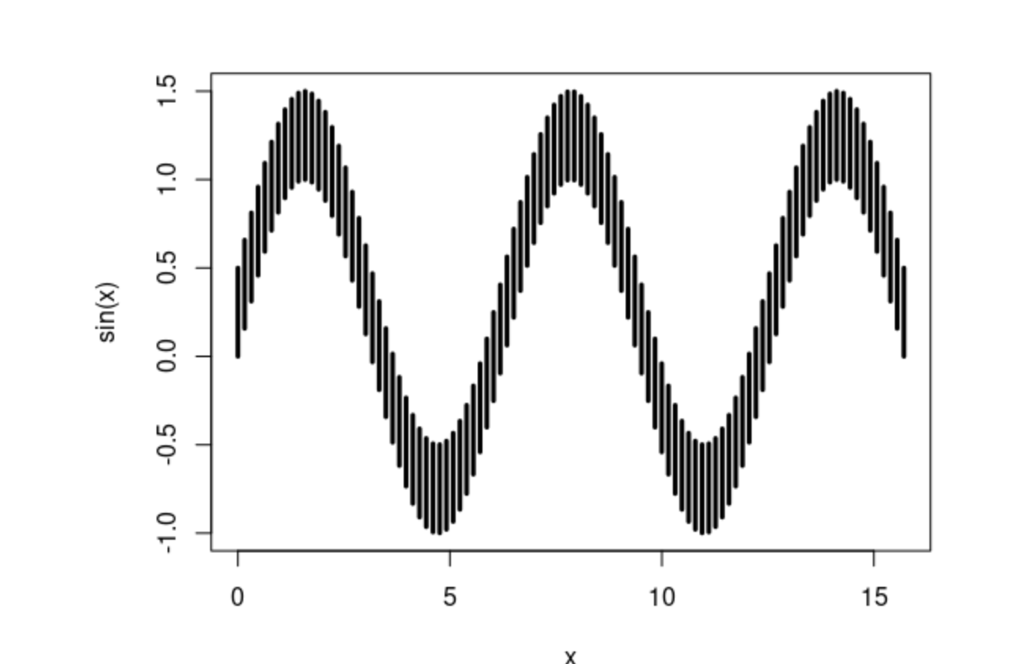
Sometimes gestalt & pre-attention compete
Pre-attentive processing for visualization: The downsides
Notes:
All same length or different?

Slide 43
Okay, what about attentive processing?
Attentive processing

Slide 44
“Apparent” magnitude
Attentive processing
Length
estimate
correctly
Area
under-
estimate
Actual
perfect correspondence
Volume
way under-
estimate
Perceived
http://makingmaps.net/2007/08/28/perceptual-scaling-of-map-symbols/

Slide 45
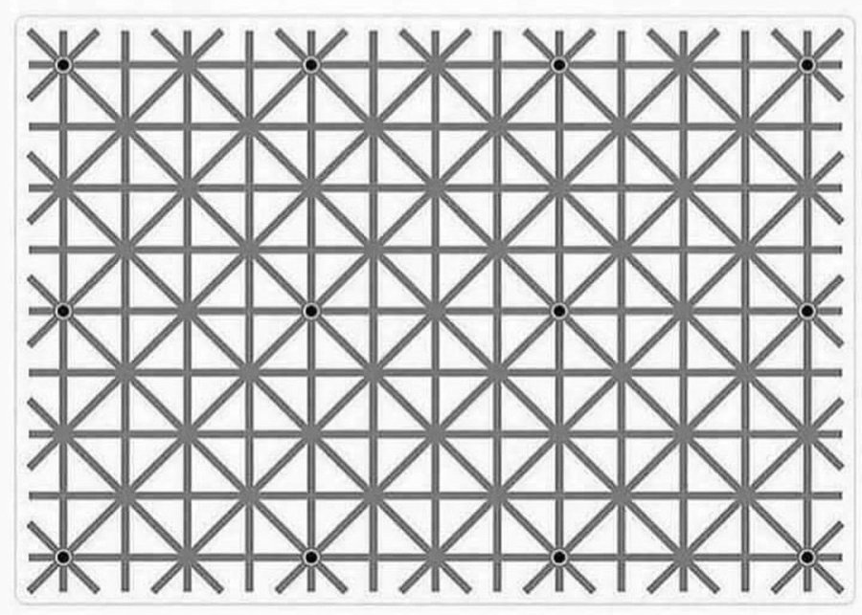
Short term “working” memory is limited
Attentive processing
https://homepage.divms.uiowa.edu/~luke/classes/STAT4580/percep.html
Notes:
Can you see all 12 black dots?

Slide 46

Color 101

Slide 47
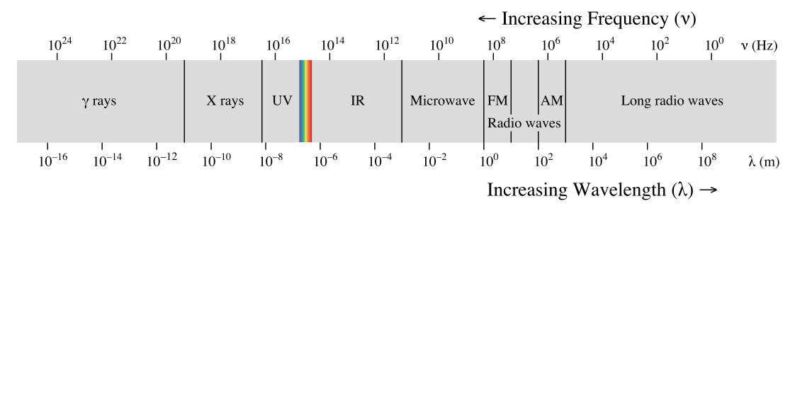
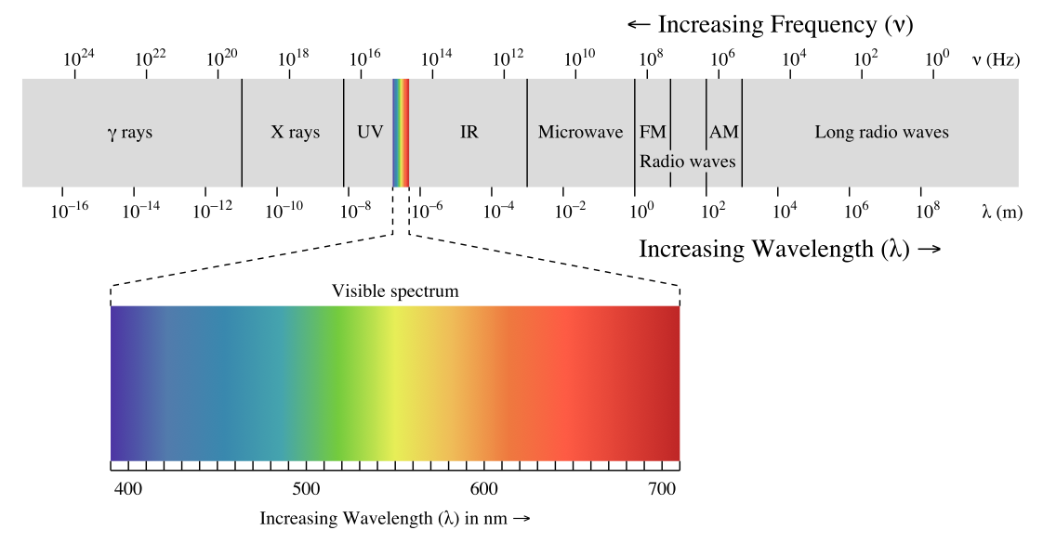

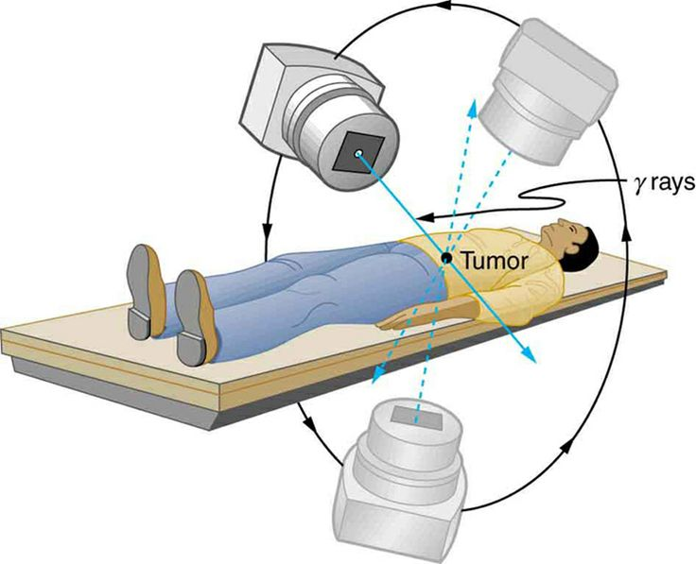
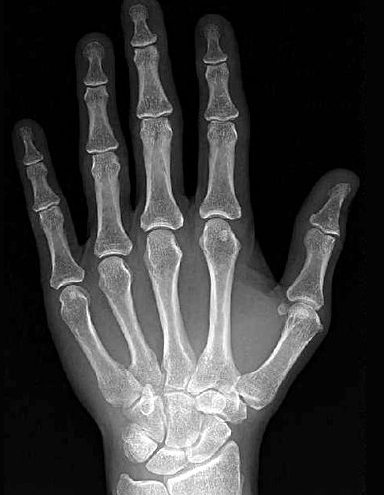

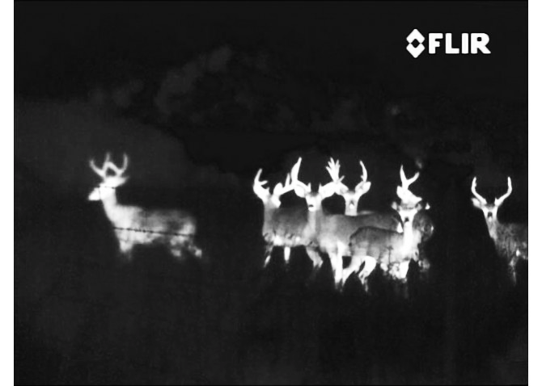
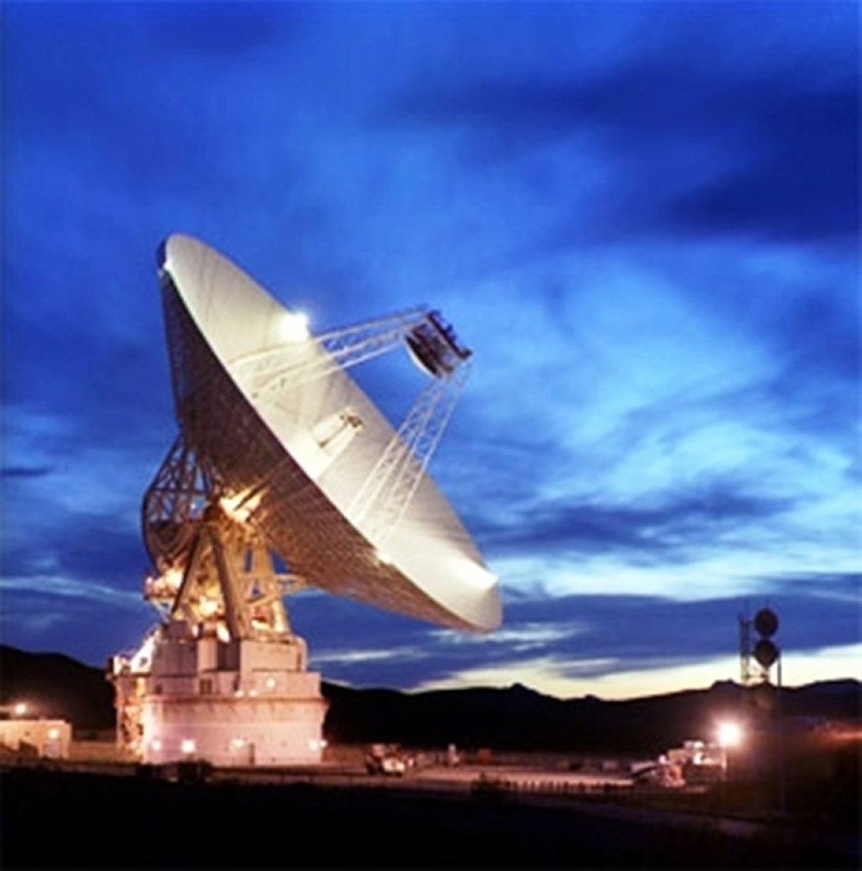
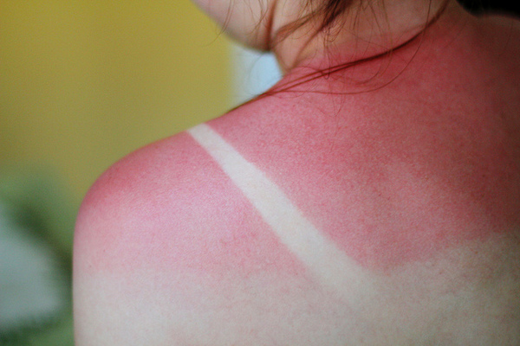
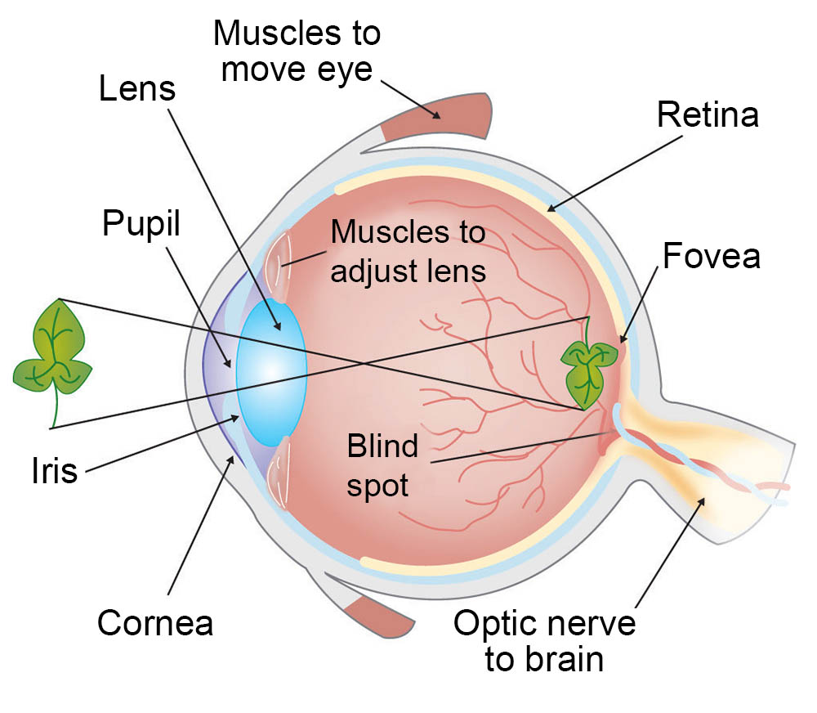
Kinds of light
Eye diagram courtesy ASU

Slide 48
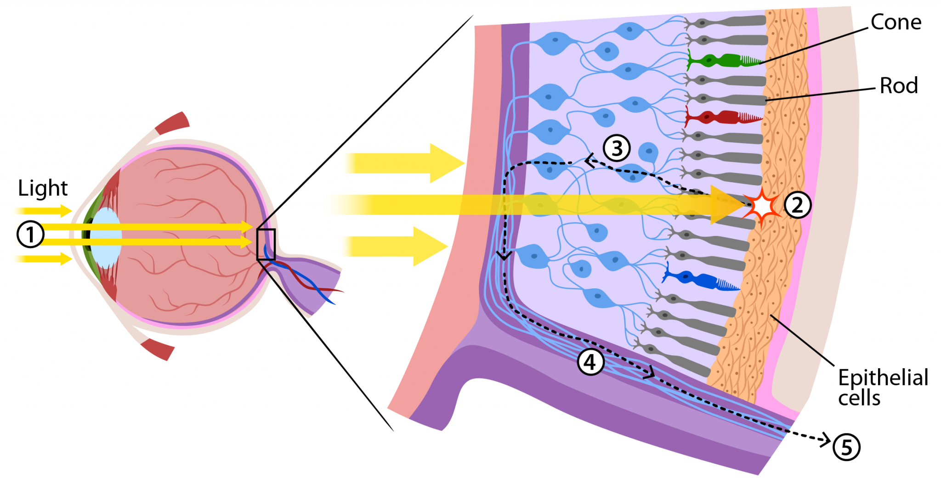
~ 6 million
How we see color
~ 100 million
https://askabiologist.asu.edu/rods-and-cones
Notes:
Rods work at very low levels of light. We use these for night vision because only a few bits of light (photons) can activate a rod. Rods don't help with color vision, which is why at night, we see everything in a gray scale. The human eye has over 100 million rod cells.
Cones require a lot more light and they are used to see color. We have three types of cones: blue, green, and red. The human eye only has about 6 million cones. Many of these are packed into the fovea, a small pit in the back of the eye that helps with the sharpness or detail of images.

Slide 49
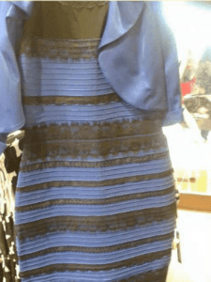
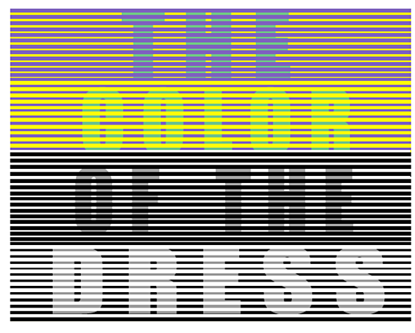
Color phenomena

Slide 50
Caveat 1: color is perceived in context
Color phenomena
Which small square is darker green?

Slide 51


Caveat 2: difference is relative
Color phenomena
Notes:
Is the difference between top and bottom rectangle the same in all cases?

Slide 52
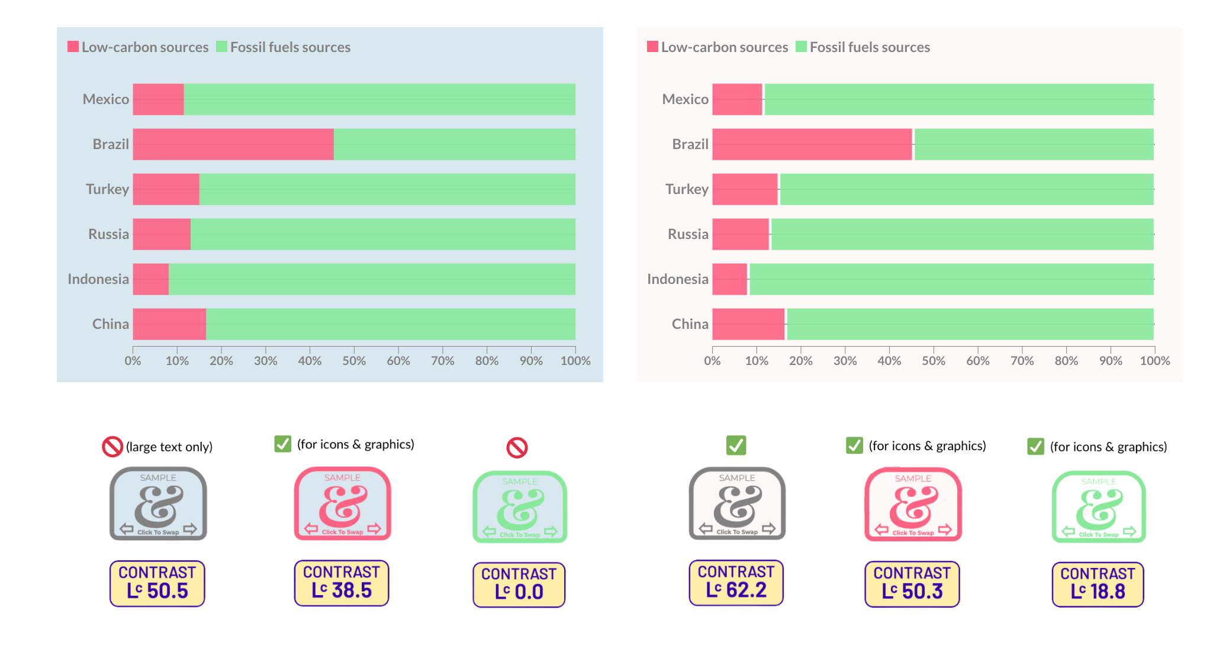
Be careful when layering colors
Color phenomenon
https://clauswilke.com/dataviz/color-basics.html
Notes:
Green and text fade into background; pink pops

Slide 53
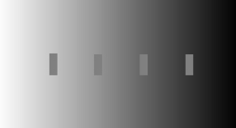
Caveat 2a: so are brightness and contrast
Color phenomena

Slide 54
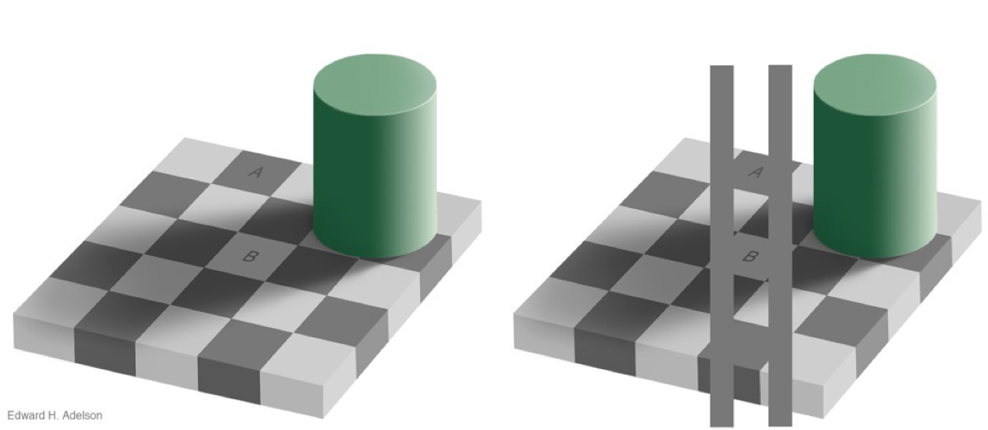
Caveat 3: mental models > perception
Color phenomena

Slide 55
Color Problems
Using a poor color scheme can also cause issues with your visualization

Slide 56
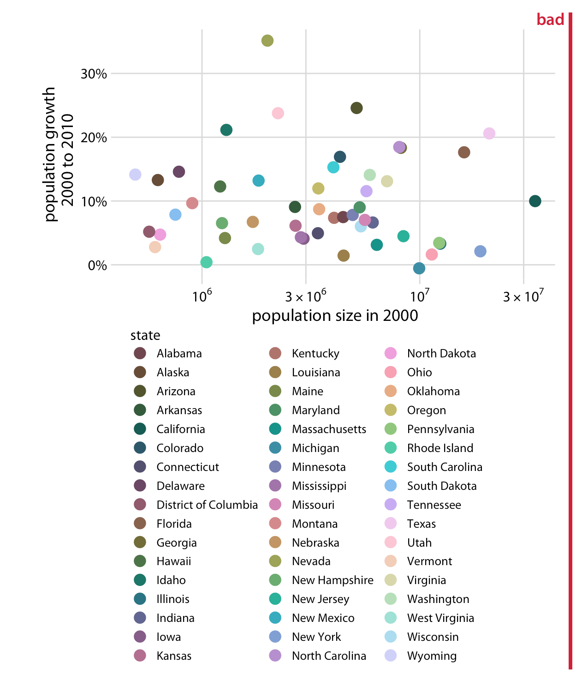
Hue mapped to too many categories
Color Problems
https://clauswilke.com/dataviz/color-basics.html

Slide 57
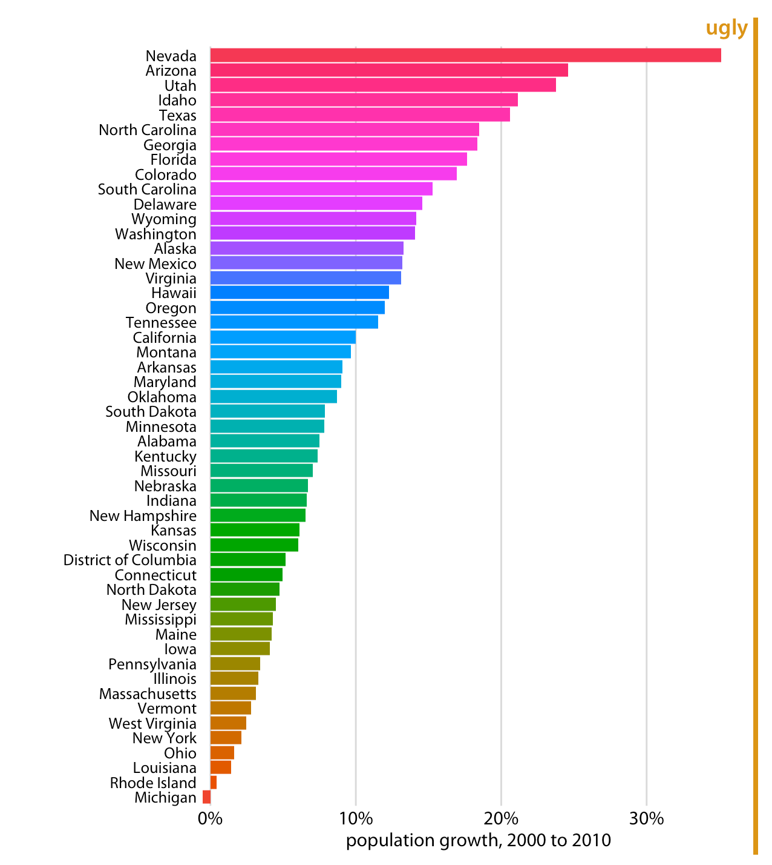
Hue not mapped to data
Color Problems
https://clauswilke.com/dataviz/color-basics.html

Slide 58
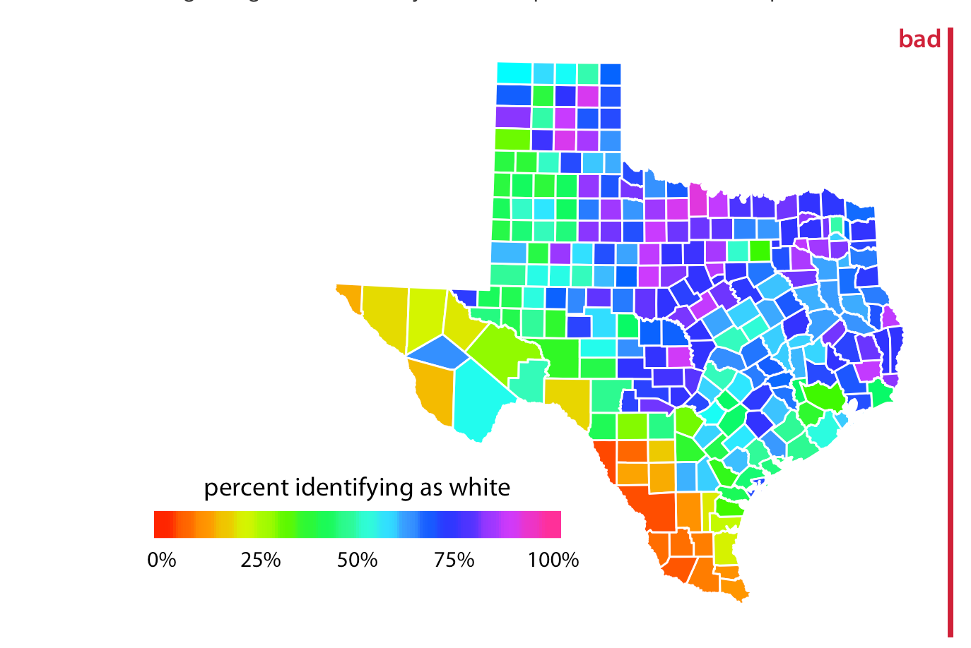
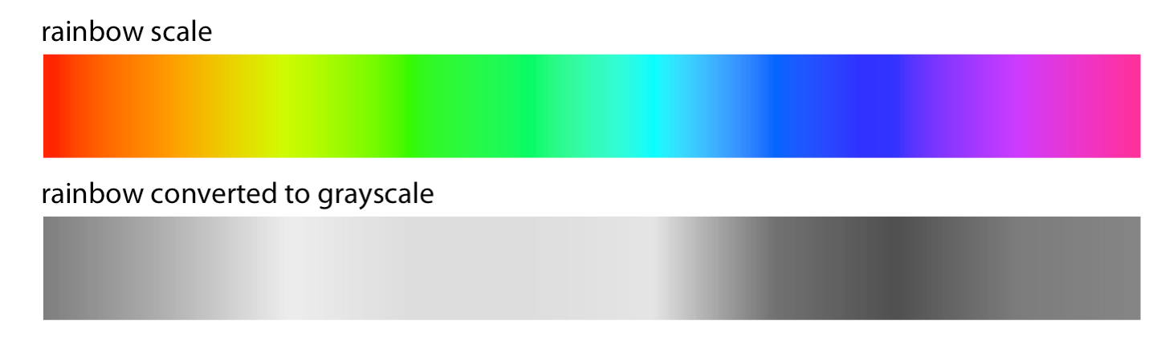
Rainbow obscures real patterns (it is not monotonic)
Color Problems
https://clauswilke.com/dataviz/color-basics.html

Slide 59
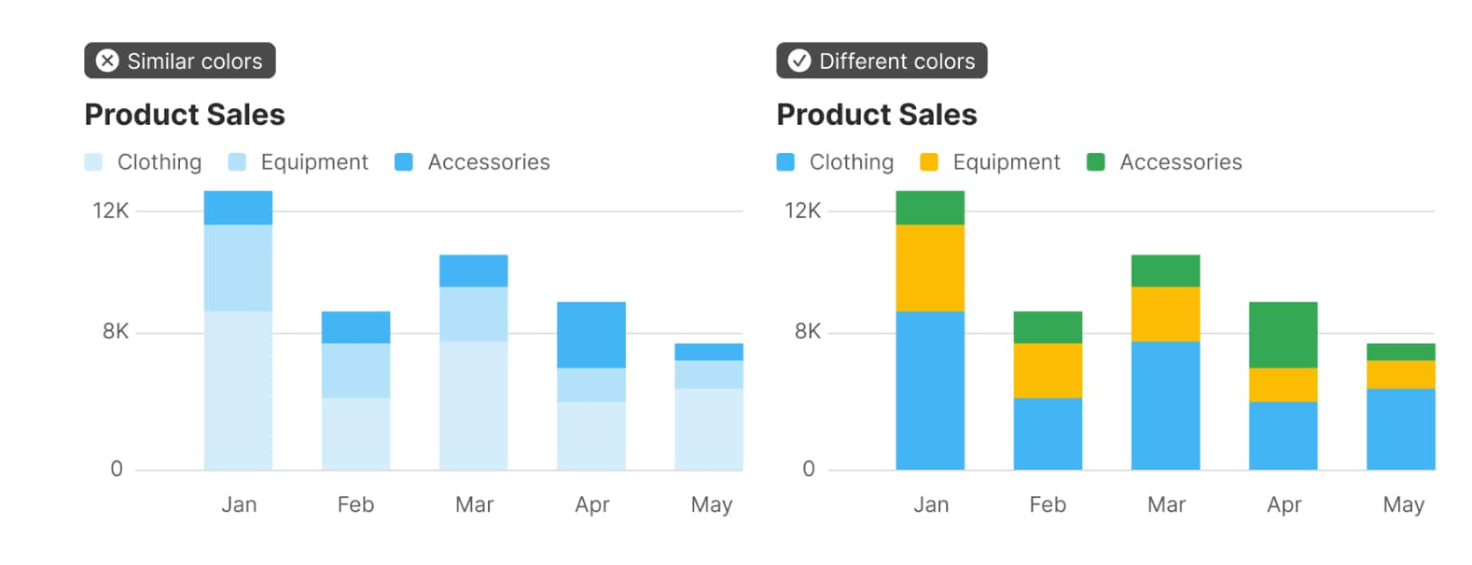
Similar colors are hard to differentiate
Color Problems
https://matthewstrom.com/writing/how-to-pick-the-least-wrong-colors/
Notes:
Similar colors – one jumps out bc most saturated
Hard to distinguish

Slide 60
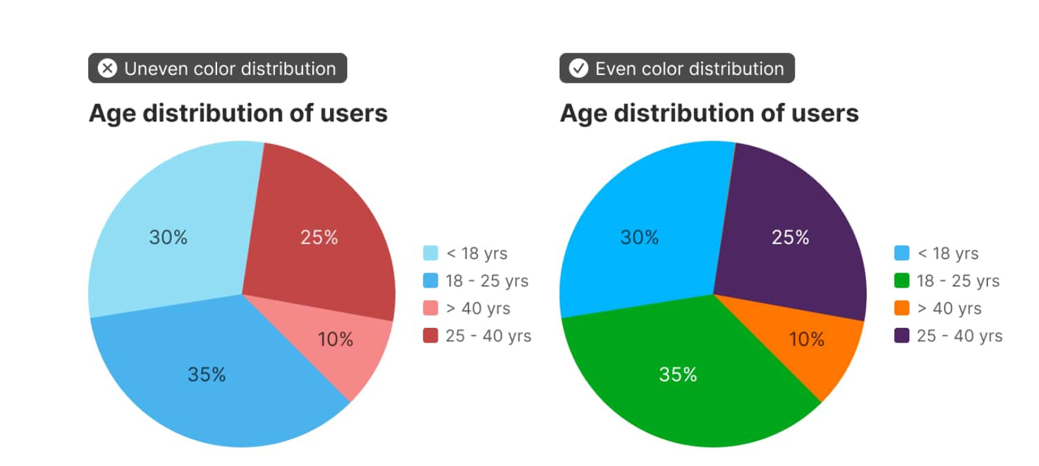
Similar colors imply relationships
Color Problems
https://matthewstrom.com/writing/how-to-pick-the-least-wrong-colors/
Notes:
Similar colors – one jumps out bc most saturated
Hard to distinguish

Slide 61
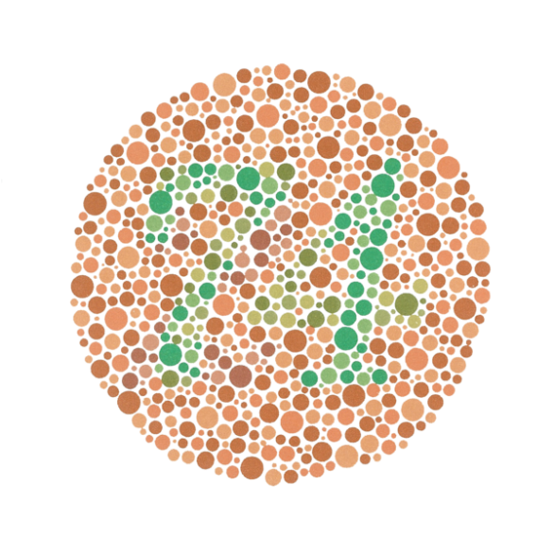
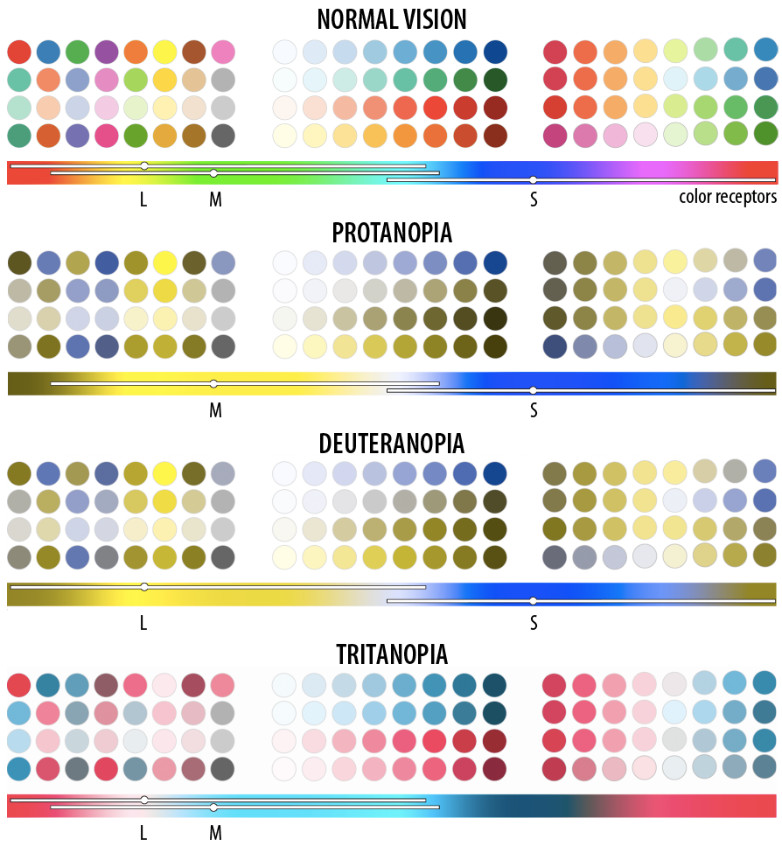
“colorblindness”
1 out of every 8 people has just 2 types of color receptors (rather than 3)

Slide 62
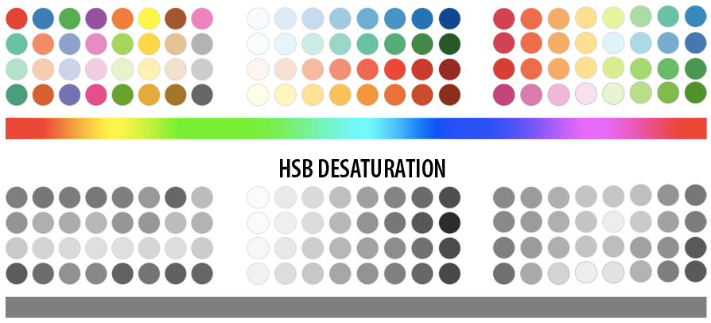
What happens when you print?
Need color scheme that converts well to grey scale

Slide 63
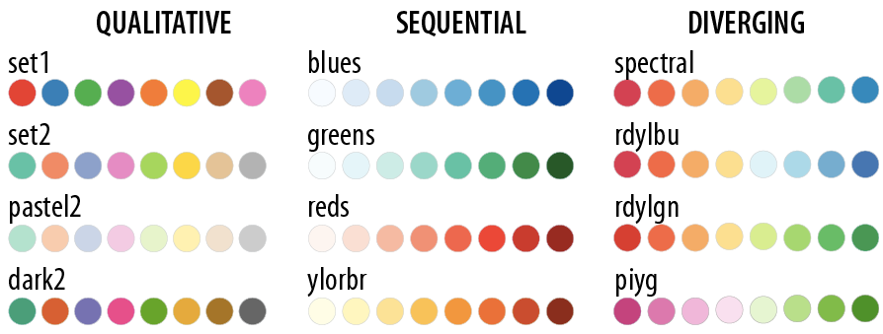
colorbrewer.org provides a whole bunch of palettes that can help us avoid these issues
This makes life a lot easier for us!
Colorbrewer palettes

Slide 64
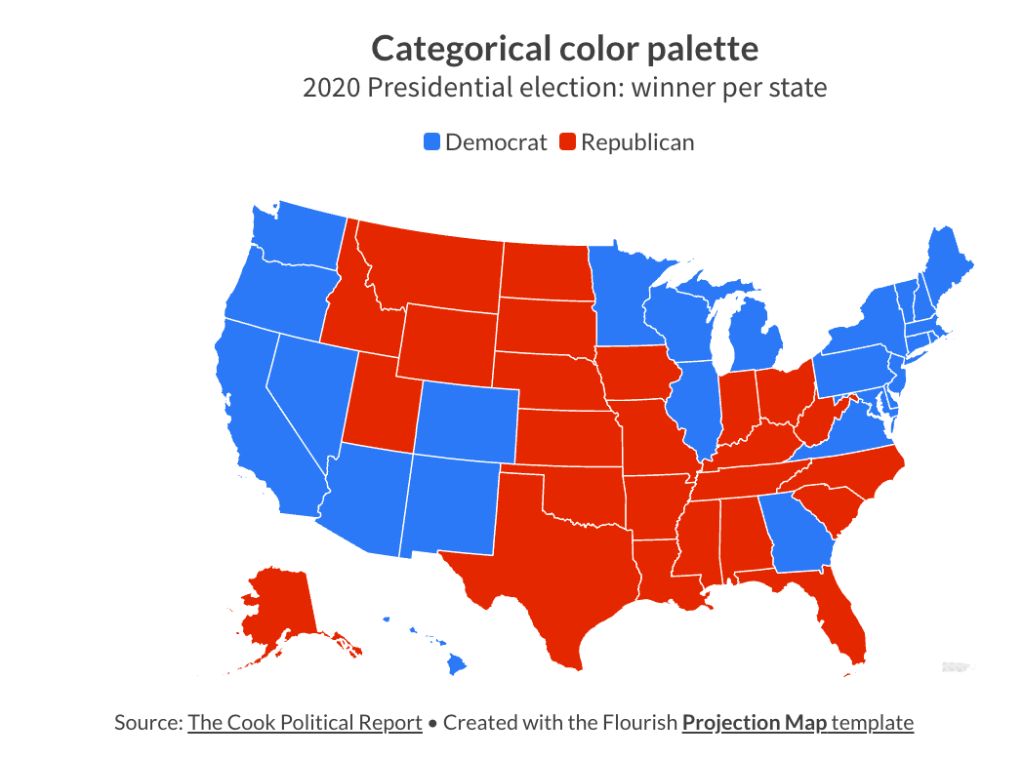
Good for nominal data
Colorbrewer palettes

Slide 65
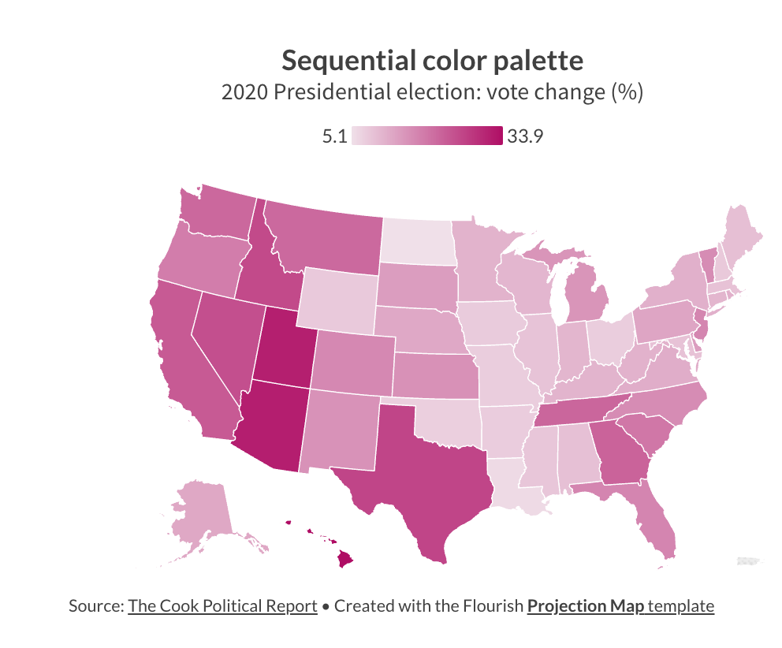
Good for sequential ordinal & quantitative data
Colorbrewer palettes

Slide 66
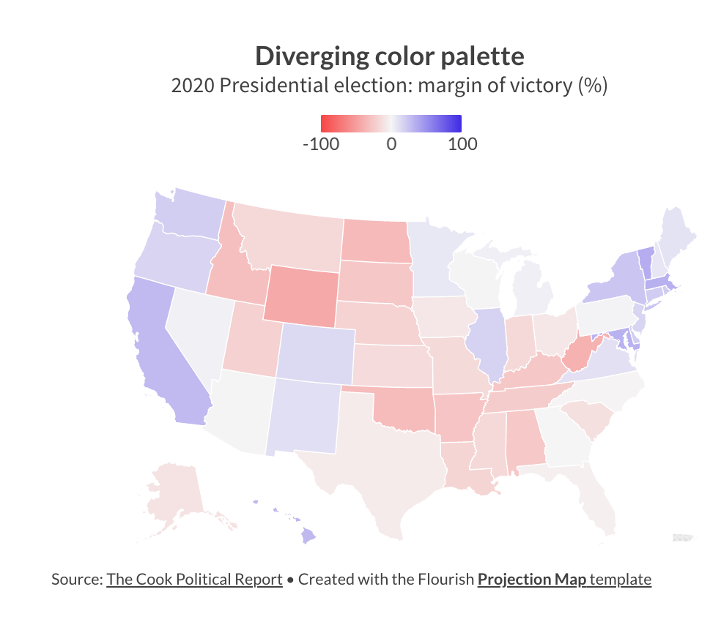
Good for diverging ordinal & quantitative data
Colorbrewer palettes

Slide 67
Visualization is about more than just aesthetics
There are compelling cognitive reasons why some visualization techniques are helpful and others aren’t
The choices we make about visual mappings can have a significant effect on performance
Takeaways: Perception

Slide 68
Find a partner and open Tableau
Choose a dataset from the course website
Create a visualization that shows an interesting trend using one of the three color channels
Modify color usage in your visualization so that the interesting trend is lost
Your turn!

Slide 69
What did you try?
What did you learn about the data?
Can you imagine a scenario that might incline someone to choose your “bad” visualization instead of a better one?
Discussion

